Slide 1
6G4Z0024 Web Development Lecture 6: Where next?
Ashley Williams
ashley.williams@mmu.ac.uk

Slide 2
Learning Objectives
To think about the next steps in learning web development:
How do I carry on learning about web development?
Is web development a good career choice?
What is the future of the web?

Slide 3
Unit Structure
# | W/C | Lecture | Lab
1 | 24/1/22 | Intro to the Unit; History; How the web works; Intro to HTML | Basic HTML
2 | 31/1/22 | HTML Forms; Intro to CSS | HTML Forms; Basic CSS
3 | 7/2/22 | Layouts with HTML and CSS; Responsiveness; Intro to JS | CSS Layouts; Basic JS
4 | 14/2/22 | JS for performing basic tasks | Working with JS
5 | 21/2/22 | REST APIs; Dynamic pages with JS | Sending/Receiving HTTP requests with JS
6 | 28/2/22 | Assignment; Next Steps | Assignment Support

Slide 4
Last week recap
REST APIs
Making API calls using JS
Creating dynamic web applications

Slide 5
Assignment
You now have all of the tools necessary to complete the assignment:
HTML (30%)
CSS (20%)
Responsive Design (5%)
JavaScript validation and POST request (35%)
JavaScript GET request with query param (10%)
All of the skills required are covered in the lectures and labs. Use them over falling into the rabbit hole of Googling!

Slide 6
Questions?

Slide 7
Recap?
https://forms.gle/46nFaLryDZQJsdr26
https://bit.ly/wd_week6

Slide 8
Next steps?
This unit has provided you with a fundamental understanding of how the web works, but where do you go next?
Font End – frameworks, technologies, designs
Back End – Writing the server, API development, DB interaction
Full Stack Development – Both
DevOps – VCS, CD/CI, Cloud

Slide 9
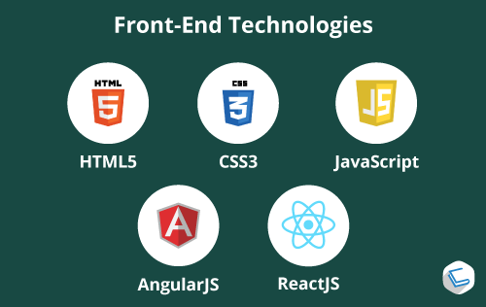
Front End Development
Concerns everything to do with how your site looks to the users
Everything we have done in this unit
HTML/CSS, JS
But also FE frameworks: Angular, React, VueJS
Frameworks do some of the work for you, provide a process and tools for structuring scalable applications

Slide 10
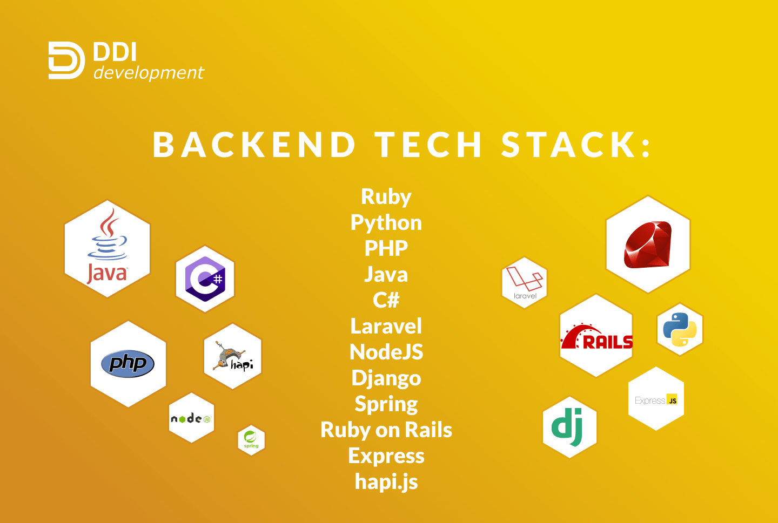
Back End Development
Concerns everything needed behind the scenes to ensure you web application works
Again, many frameworks: Django, Rails, NodeJS/Express
But also: API development, architecture (e.g. microservices), database design and interaction

Slide 11
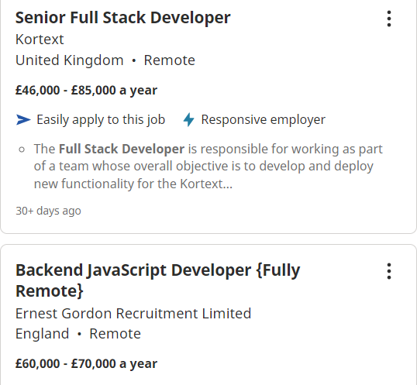

Full Stack Development
All of the above
Full Stack developers do both the front end and back end work
More to learn, but highly rewarding

Slide 12

DevOps

Slide 13
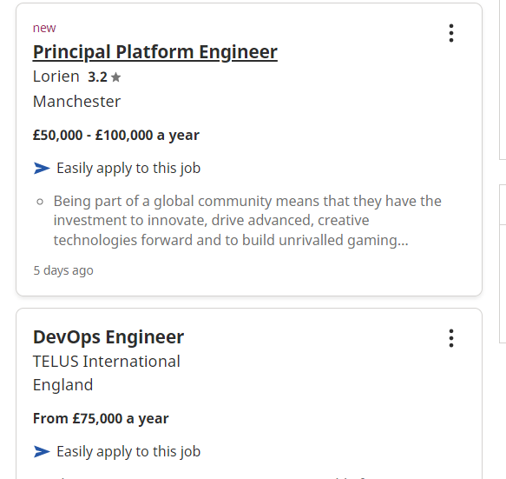
DevOps
Again, very highly rewarding and sought after skillset
“increases an organization’s ability to deliver applications and services at high velocity: evolving and improving products at a faster pace than organizations using traditional software development and infrastructure management processes.” - Amazon

Slide 14
Future Units: Full Stack Development (Level 5) (with me)
Learn about full stack development, API development, web architectures
API first development assignment
Expand on your JS abilities
Learn about back end programming, how to implement API’s, how to interact with databases

Slide 15
Future Units: Mobile Computing (Level 6) (also with me)
Learn about developing applications for mobile devices
Taught using React Native, which is JS that compiles into native application code for Android and iOS (one code repo means less development costs)
React Native is a subset of the React framework, so you’re learning two frameworks in one
Provided with a complex API and server application. You code the front end application to interact with the API (like this unit on steroids)
Previous assignments: Twitter, Trip Advisor, Facebook

Slide 16
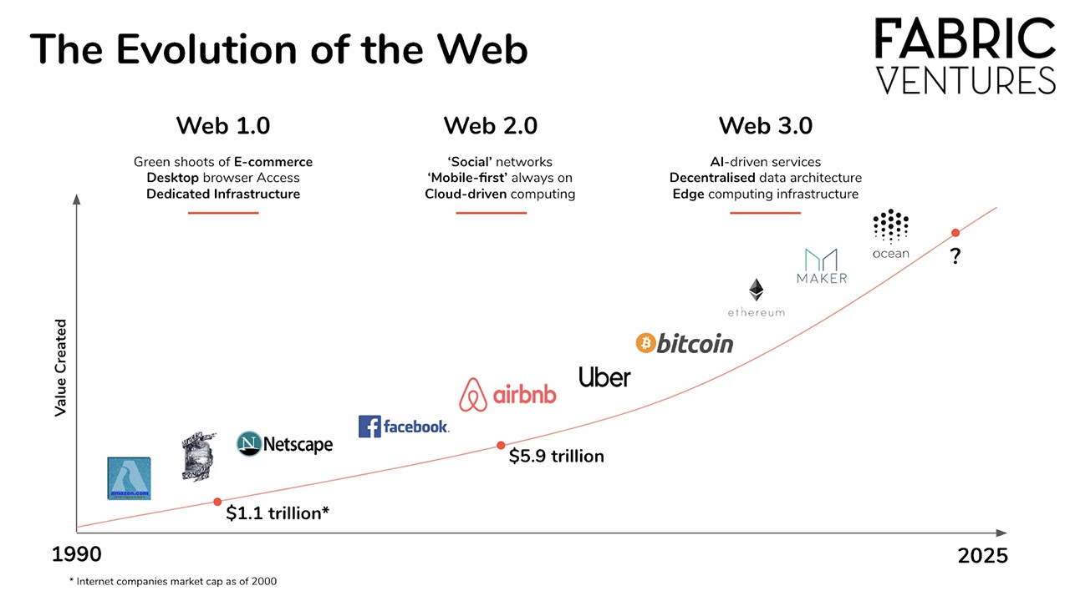
Where is the web going?

Slide 17

Current trends: Progressive Web Applications (PWAs)
Web applications that look and feel like native applications
Ultimate usability, best of both worlds
(watch 8:30 – 12:00)

Slide 18
Current trends: Others
Integrated AI solutions
AI Chatbots
Voice based commerce
Single page websites (SPAs)
Accelerated mobile pages (AMP)
Dark theming UI and low light UX
3d elements and enhanced animation
Internet of things
Data security
Push notifications

Slide 19

Web 3.0

Slide 20
How to become a billionaire in 5 years…
Web 3.0 apps that we need:
Social networks
Chat apps
Video sharing
Banking
Shopping

Slide 21
This week's lab
Assignment support
Work on your assignment
Last opportunity to get help from the lab tutors

Slide 22
Closing words
Congratulations on (almost) completing the unit
I hope you have enjoyed the unit and feel like you understand the basics around web development
Good look in your assignments
I’ll see some of you next year for Full Stack Development ☺

Slide 23
Questions?

